Slide 1
Insider Threat
Forensic Investigation

Slide 2
WKST07 (172.16.50.137) – Reggie Habeo
While investigating suspicious activity in the OT network, the Security team identified an email thread sourcing from a Russian email provider (Yandex).
This seemed highly unusual since neither Magnum Tempus Financial nor Tombstone had vendors or customers that would use a Yandex email address.
The email recipient was Reggie Habeo an IT Systems Administrator

Slide 3
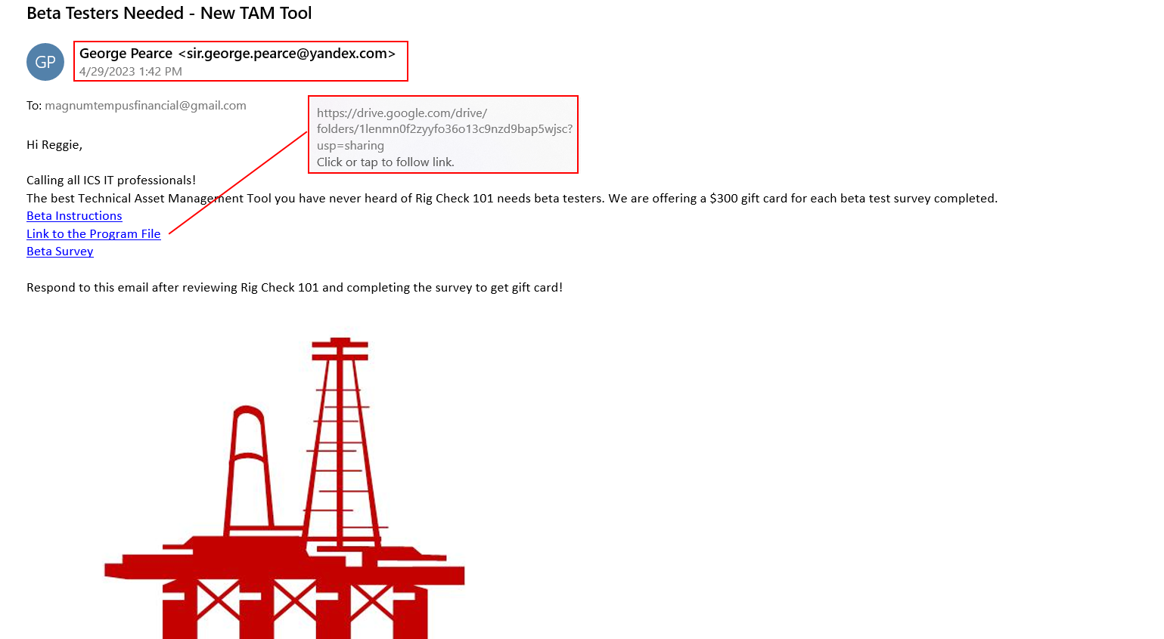
Project Obsidian
WKST07 (172.16.50.137) – Reggie Habeo

Slide 4
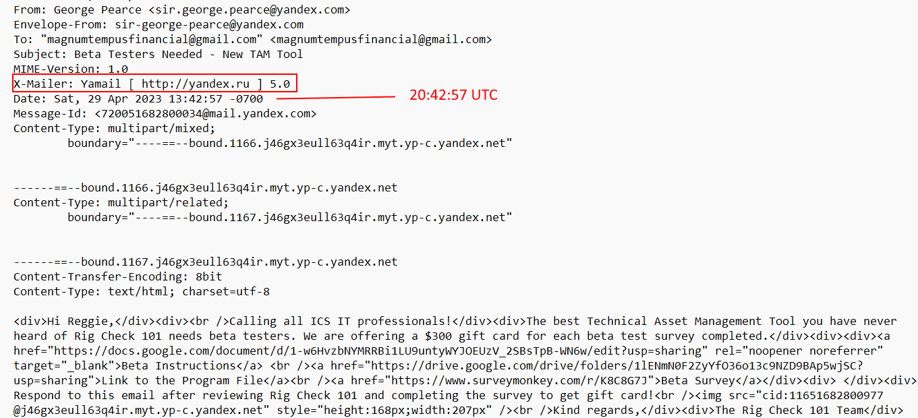
Project Obsidian
WKST07 (172.16.50.137) – Reggie Habeo

Slide 5
WKST07 (172.16.50.137) – Reggie Habeo
A review of Reggie's browser history showed that no record of browsing was recorded. Another highly suspicious finding. After asking Reggie about this he stated that he “Regularly clears his browser history for Security reasons”.
$MFT artifacts indicate that two ICS_NMAP install programs were downloaded on his system shortly after he received the email from “George Pearce”. Notice the Zone.Identifier ADS.
When asked directly about downloading files from the email link, Reggie stated that he thought it was a legitimate copy of ICS_NMAP.

Slide 6
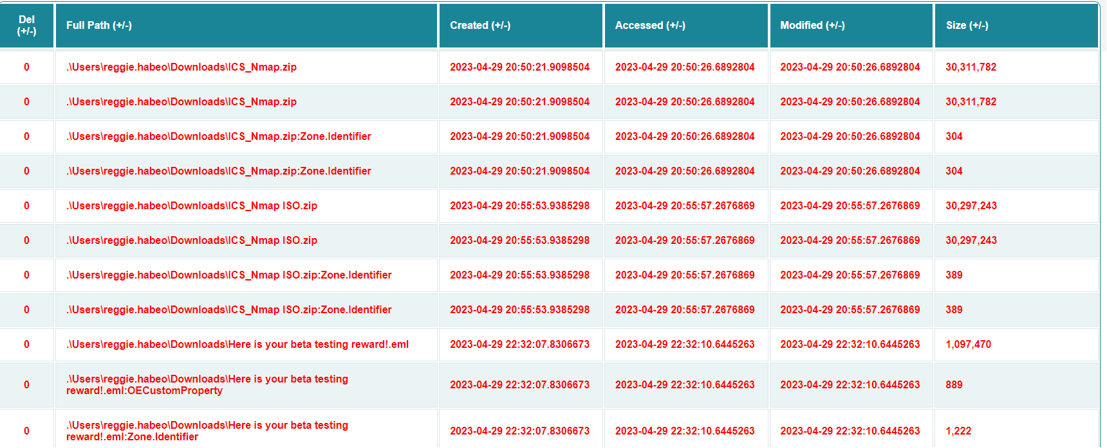
Project Obsidian
WKST07 (172.16.50.137) – Reggie Habeo

Slide 7
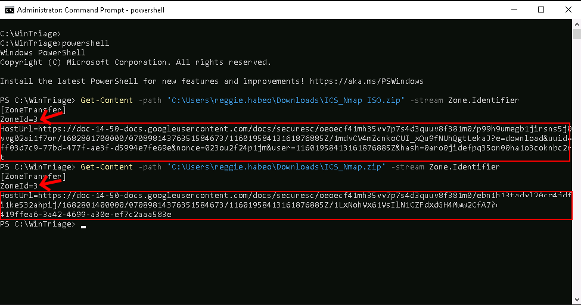
Project Obsidian
WKST07 (172.16.50.137) – Reggie Habeo

Slide 8
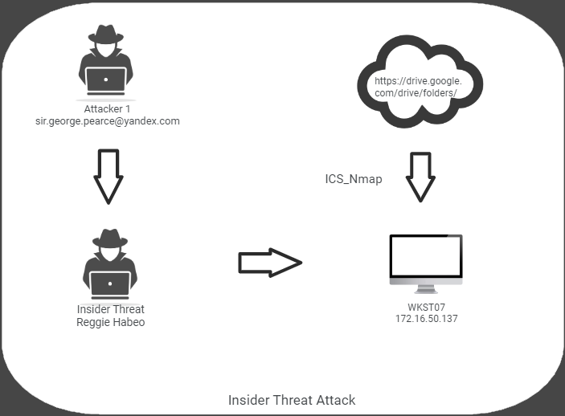
WKST07 (172.16.50.137) – Reggie Habeo

Slide 9
WKST07 (172.16.50.137) – Reggie Habeo
Analysis of the ICS_Nmap.Zip and ICS_Nmap.iso files determined that they were maliciously modified versions of NMAP that would provide the actor access into the environment. Investigation is ongoing to determine if Reggie knew that this was malicious software and was colluding with the hostile actor, or if Reggie was duped.
There is no forensic evidence to suggest that the software was installed or the actor gained access to the environment.

